Slide 1
Machine Learning Toolkits Basics
Yaohua Wang
Electrical and Computer Engineering
The University of Iowa
Aug. 25th, 2023

Slide 2
Agenda
Set up platforms for developing machine learning projects
Anaconda, VSCode
Introducing Python Basics
Introducing machine learning libraries
1. Pandas
2. Scikit-Learn
3. Matplotlib

Slide 3
Set up platforms -- Anaconda, VSCode
Set up platforms for developing machine learning projects
Anaconda, VSCode
https://www.anaconda.com/products/individual
https://code.visualstudio.com/

Slide 4
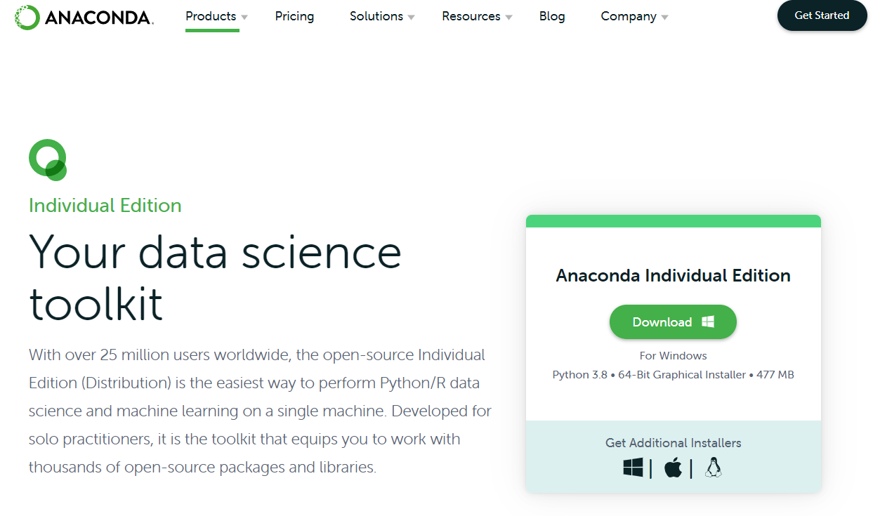
Install Anaconda

Slide 5
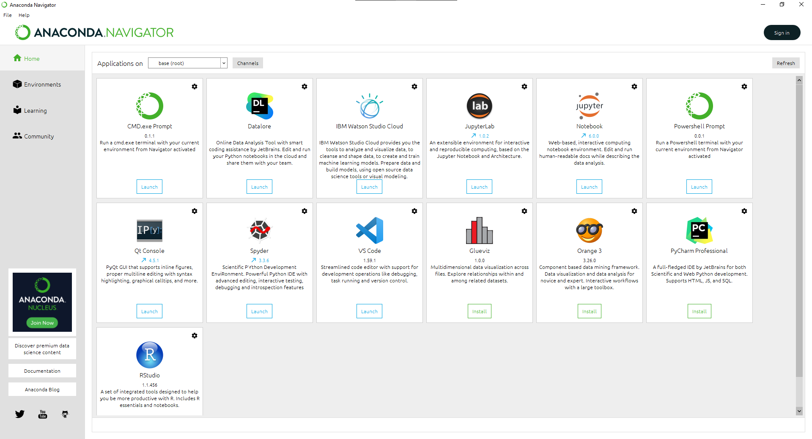
Install Anaconda

Slide 6
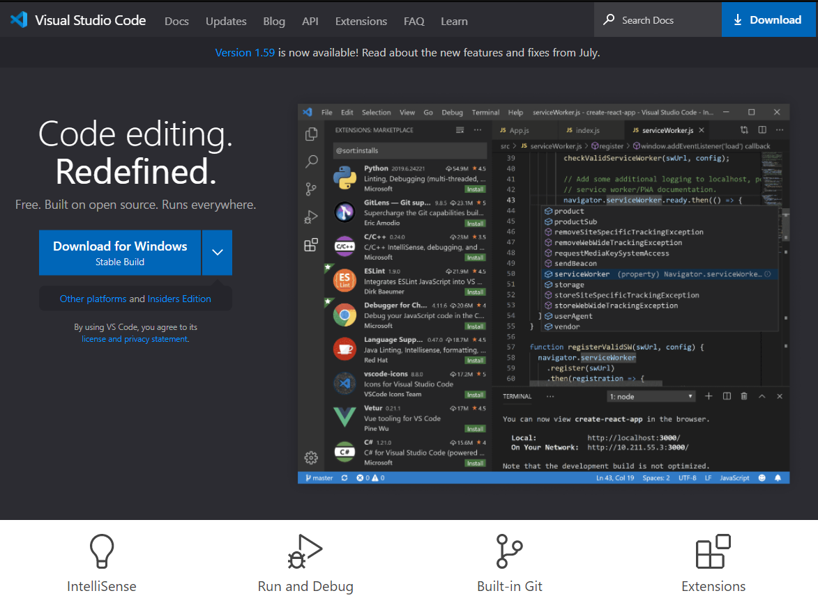
Install VSCode

Slide 7
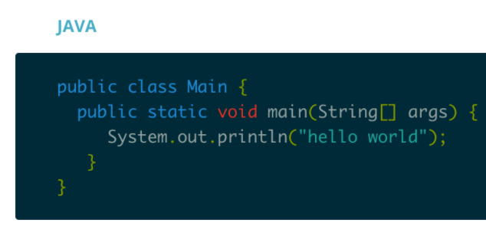
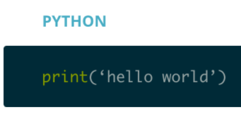

Introducing Python Basics – Why Python?
Python is easy to use, general-purposed, making it a great choice for beginners and experts alike. Python’s readability makes it a great first programming language — it allows you to think like a programmer and not waste time with confusing syntax.
Useful link for Python Tutorial:
https://www.kaggle.com/learn/python

Slide 8
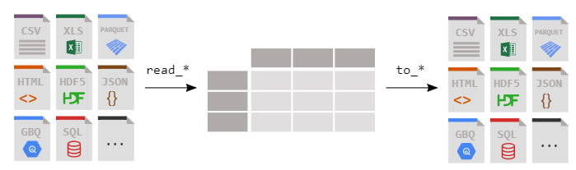
Introducing machine learning libraries -- Pandas
“Pandas” is a fast, powerful, flexible and easy to use open-source data analysis and manipulation tool, built on top of the Python programming language.
More Details: https://pandas.pydata.org/docs/user_guide/index.html

Slide 9
Introducing machine learning libraries -- Scikit-learn
Scikit-learn is an open-source machine learning library that supports supervised and unsupervised learning. It also provides various tools for model fitting, data preprocessing, model selection and evaluation, and many other utilities.
Classification
Regression
Clustering
Dimensionality reduction
Model selection
Preprocessing
For more details:
https://scikit-learn.org/stable/index.html

Slide 10
Machine Learning Community -- Kaggle
https://www.kaggle.com/

